Slide 1

STUDENT AID DATABASE SYSTEM
GROUP 10:
Asfan sajid
Disha sengar
Latish talreja
Sandhya goswami
Sushmitha jogula

Slide 2
content
Database Purpose
Business Problems Addressed
System Flow
Database ERD Design
Database Implementation Highlights
Reports

Slide 3
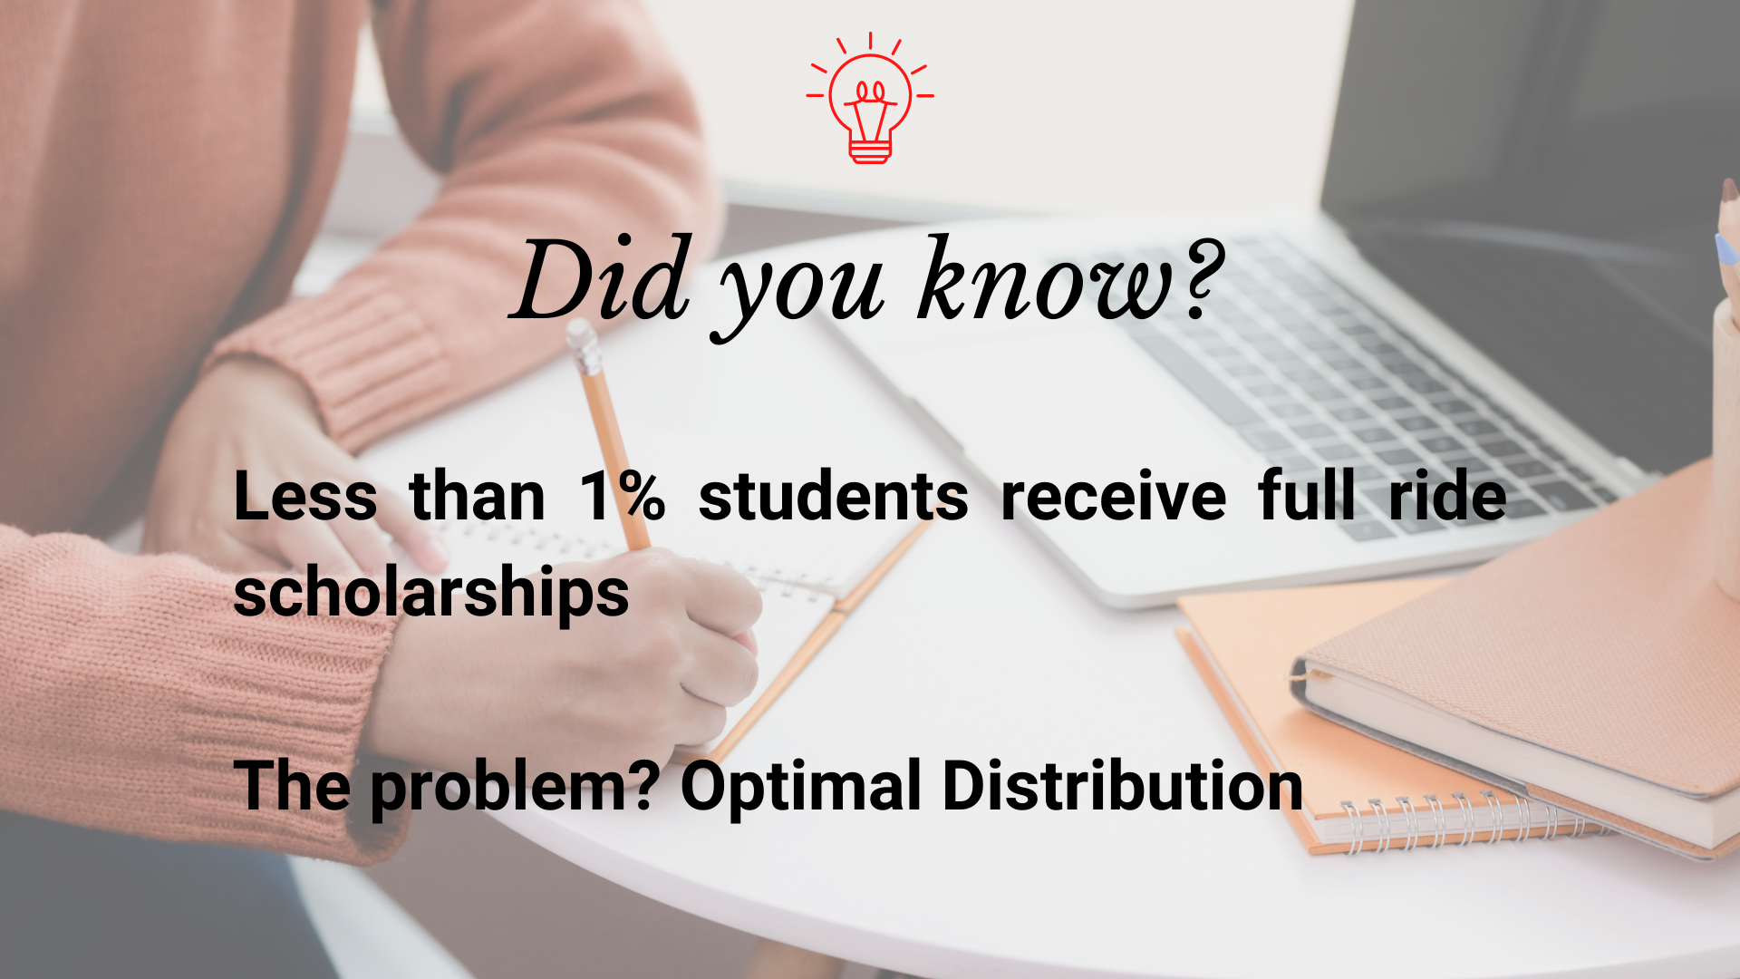
Database purpose
Collect all the disparate information
Financial aid granted according to student profile
System users - students, donors, and university representatives
Business problems addressed
Donors provide aid to verified students
University representatives verify the student’s status.
Provide statistical data
Allow students to request for tuition aid

Slide 4
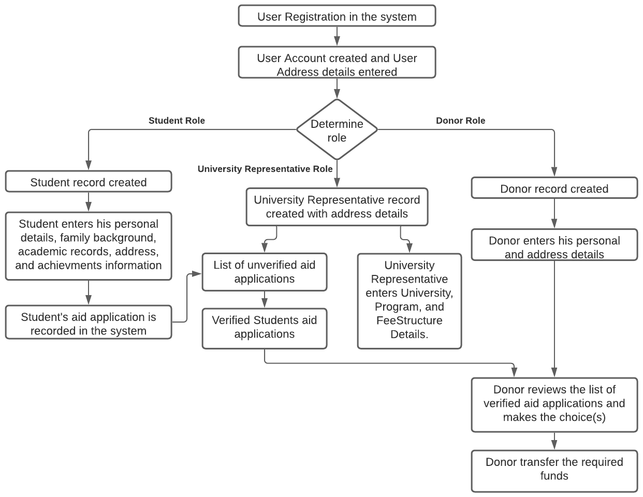
System flow

Slide 5
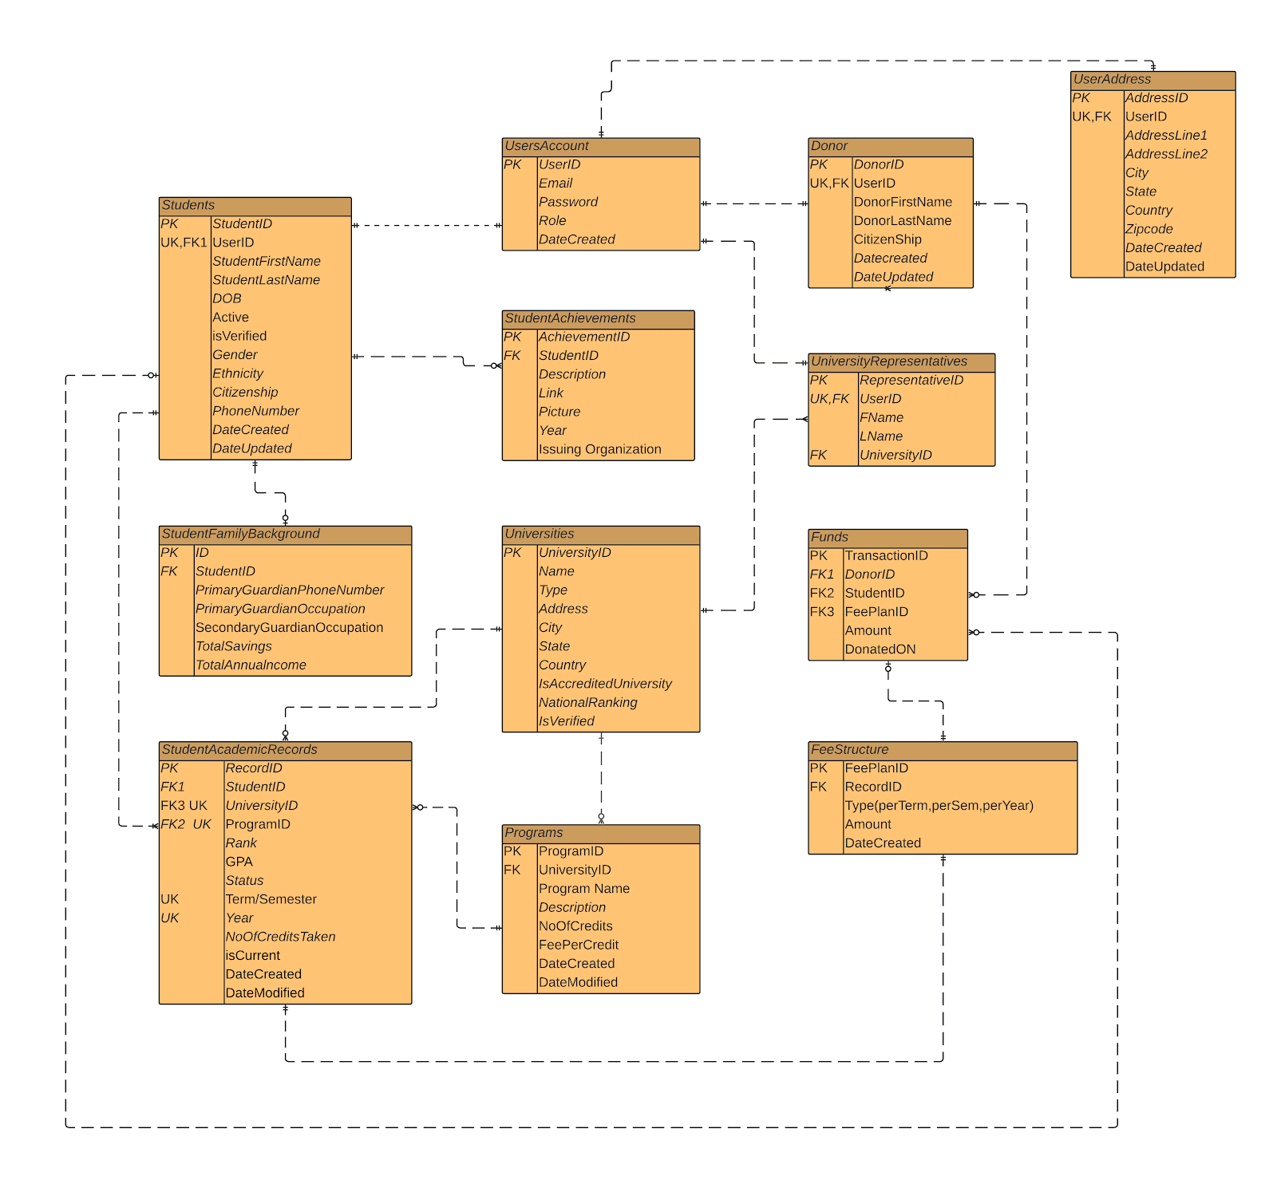
Database erd design

Slide 6
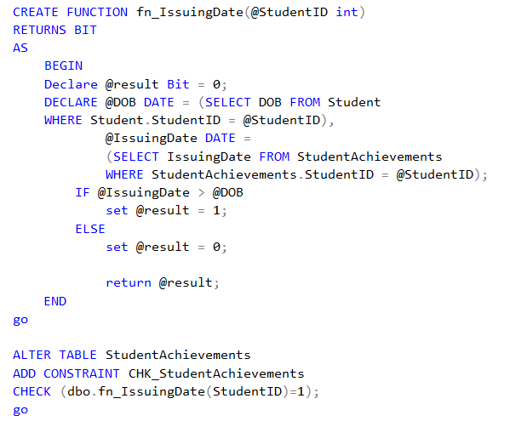
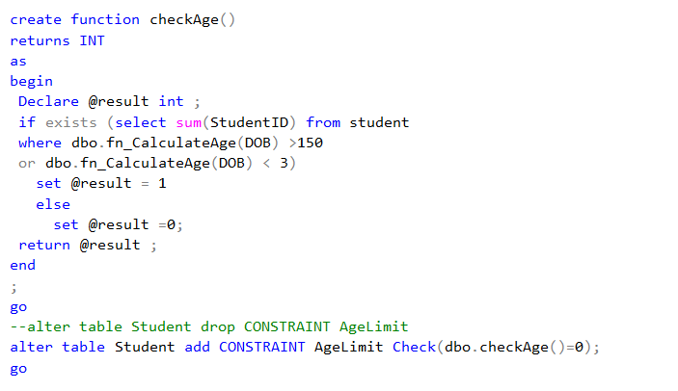
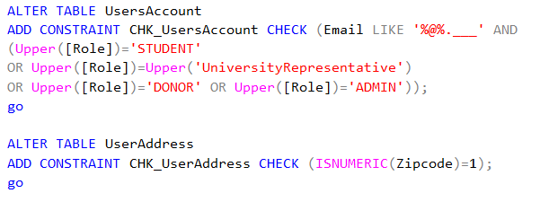
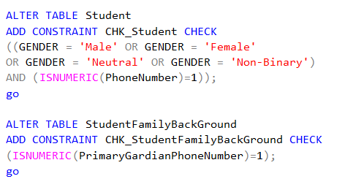
TABLE-LEVEL CHECK CONSTRAINTS
2
1
3
5
4
6

Slide 7
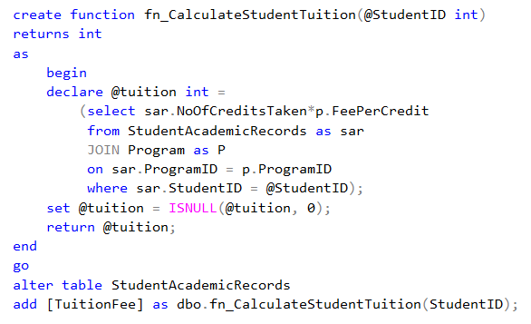
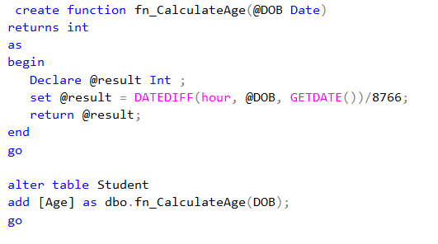
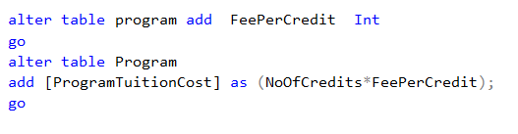
COMPUTED COLUMNS
1
2
3

Slide 8
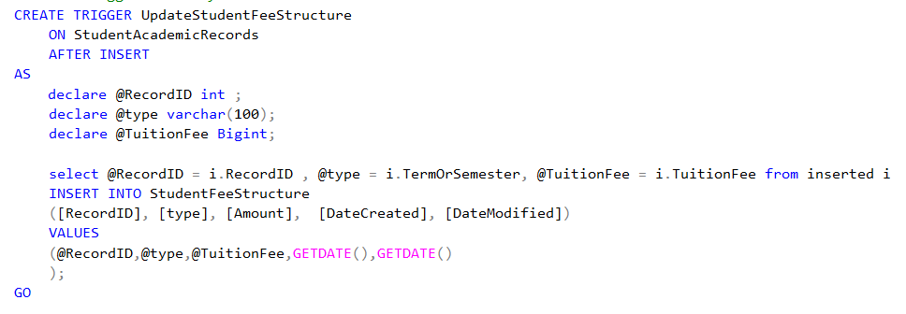
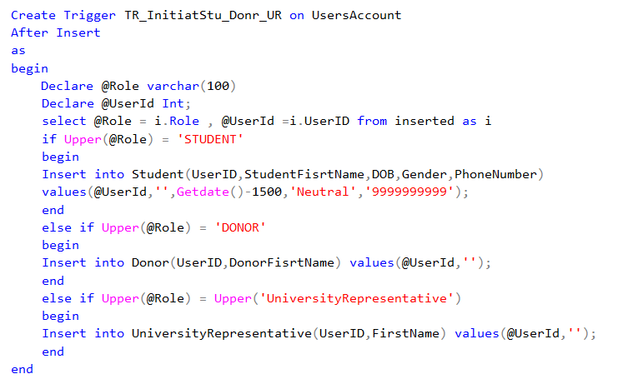
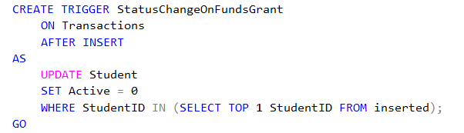
TRIGGERS
1
2
3

Slide 9
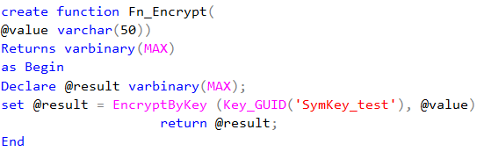
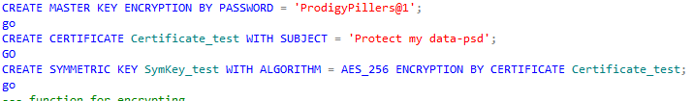
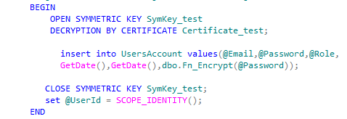
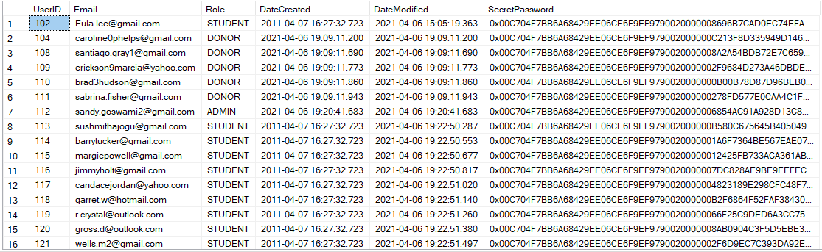
Encryption

Slide 10
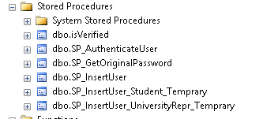
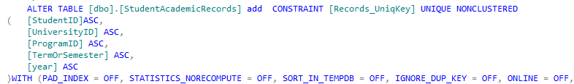
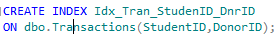
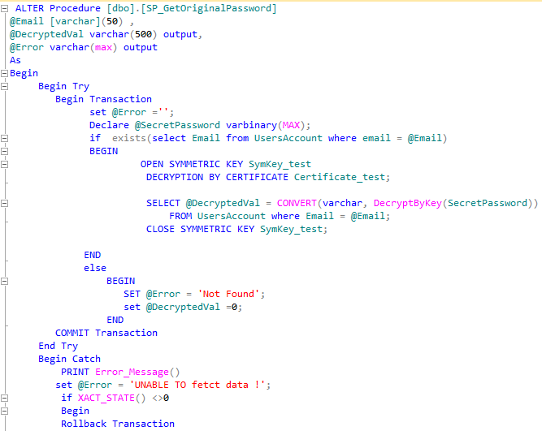
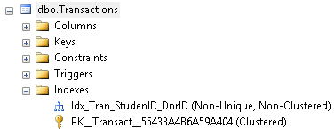
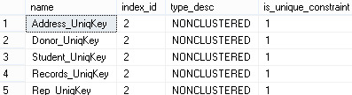
Stored procedure and Indexes
Unique key
Stored Procedure
Nonclustered Indexes(Unique Keys)

Slide 11
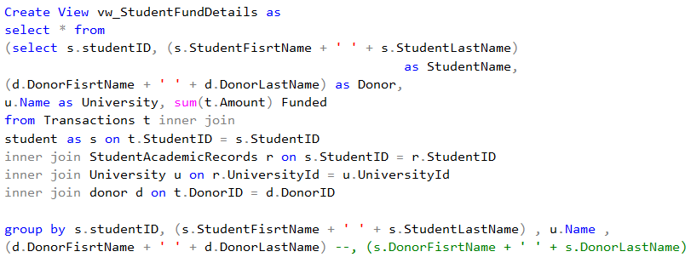
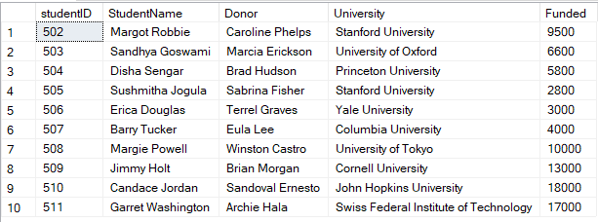
VIEWS
Student fund details

Slide 12
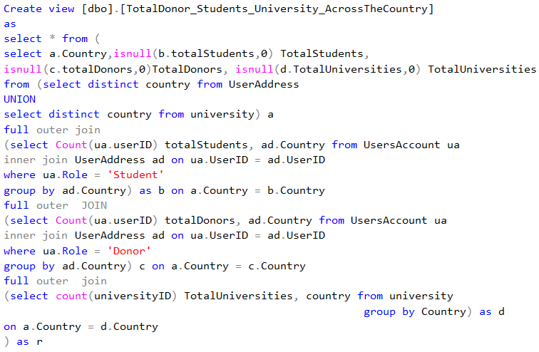
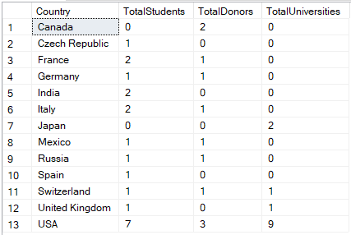
VIEWS
Total number of students, universities, and donors country wise

Slide 13
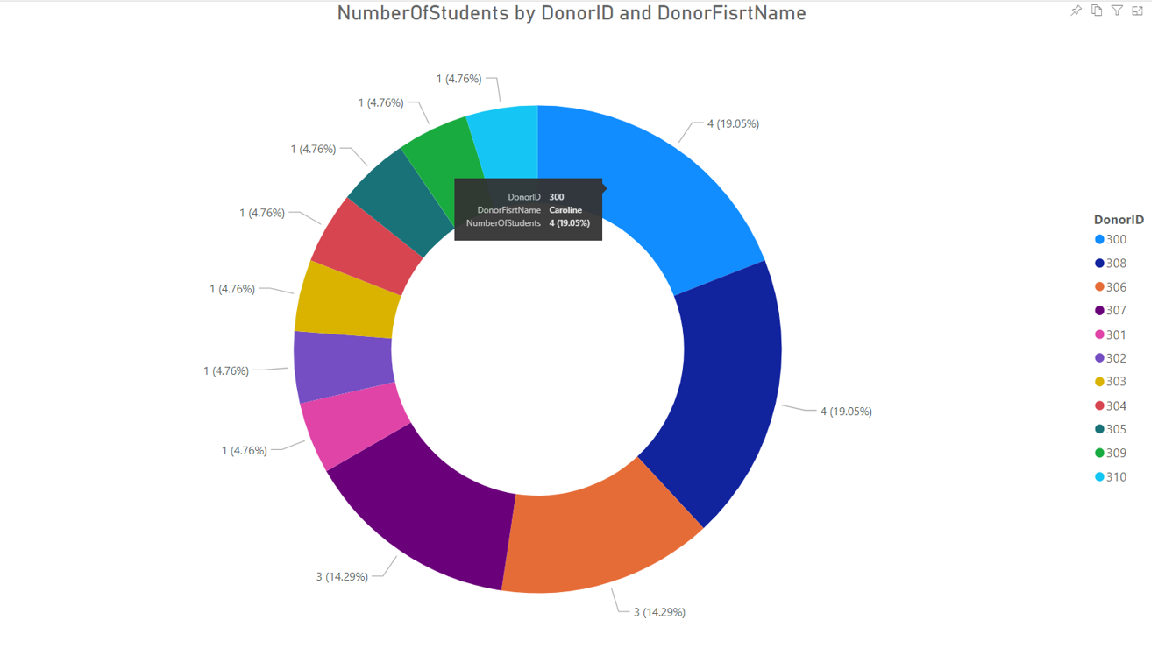
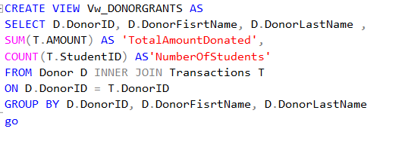
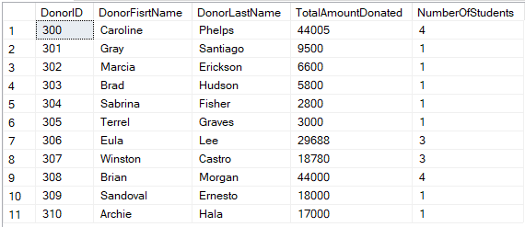
VIEWS
Grants by donors

Slide 14
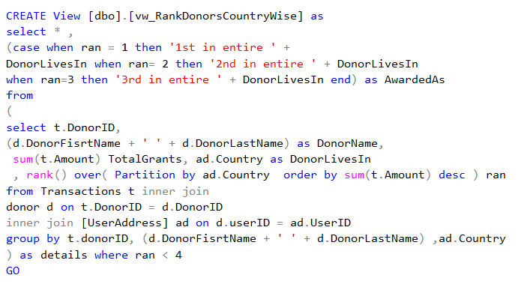
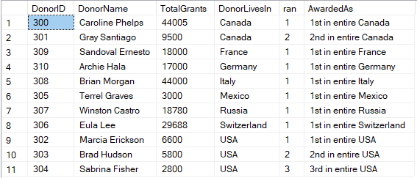
VIEWS
Country wise ranks of donors

Slide 15
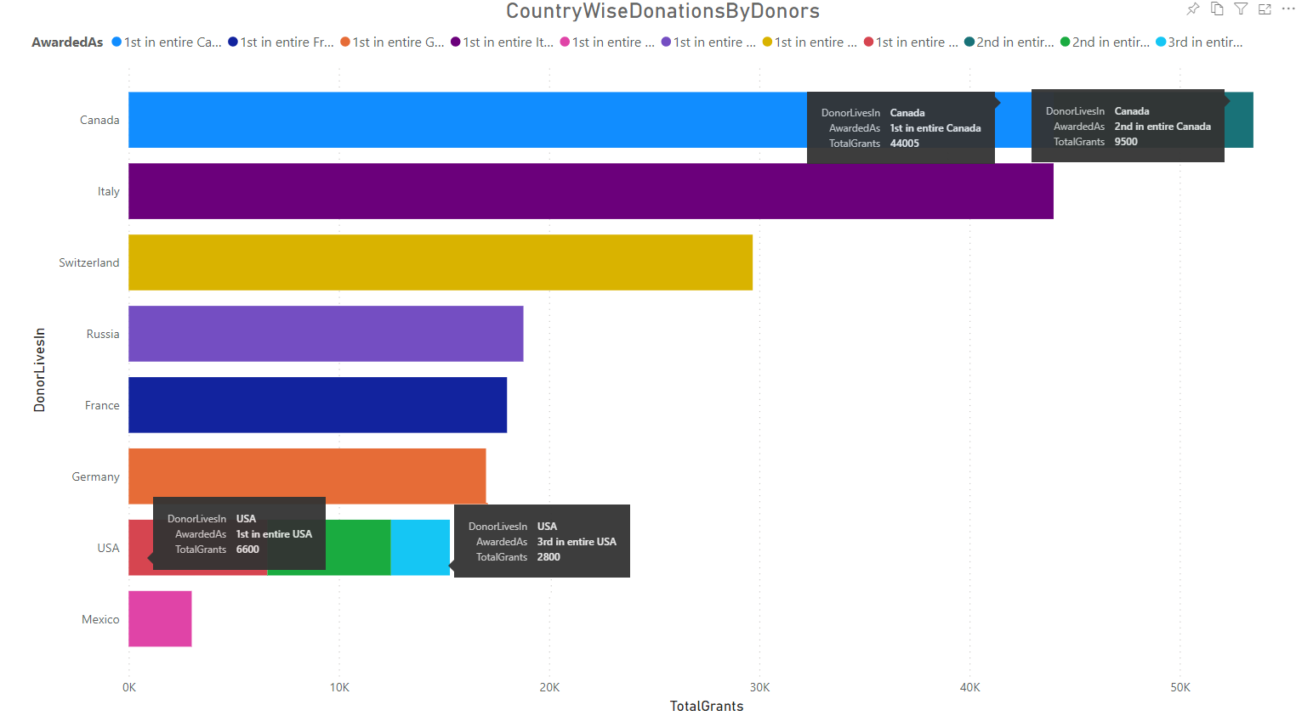
REPORT

Slide 16
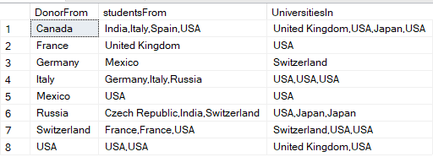
VIEWS
COUNTRIES OF DONORS, STUDENTS, UNIVERSITIES

Slide 17
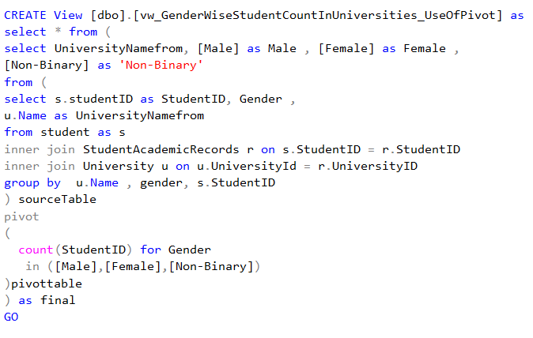
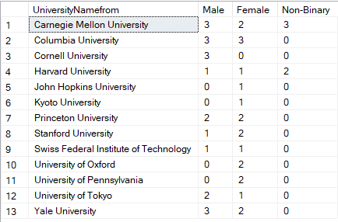
VIEWS
GENDER WISE STUDENT COUNT IN UNIVERSITIES

Slide 18
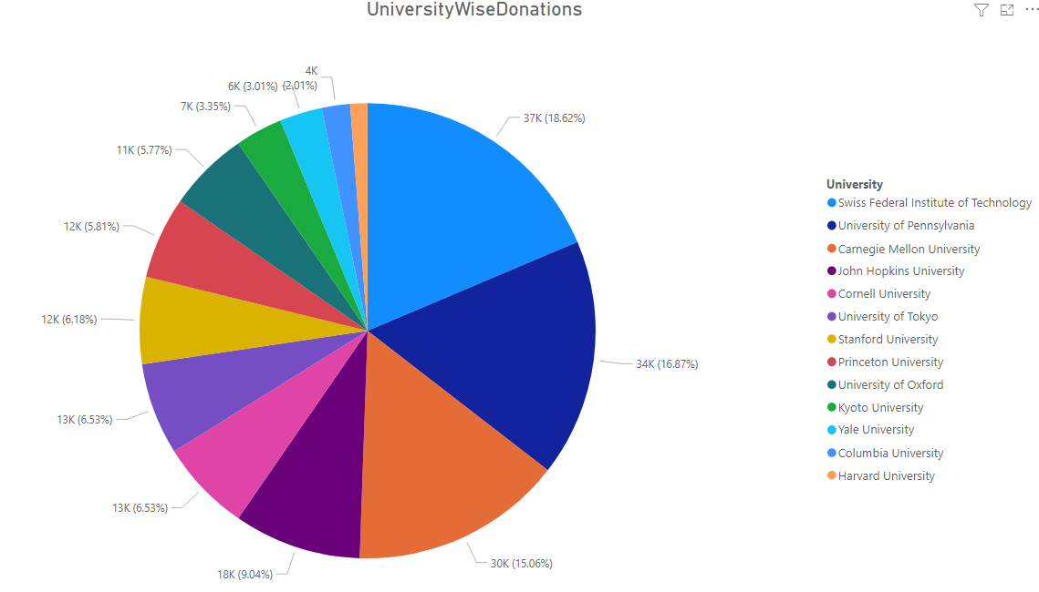
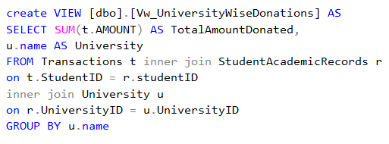
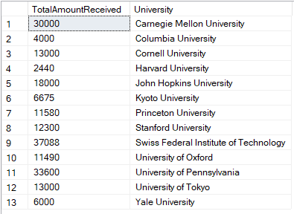
VIEWS
GRANTS RECEIVED BY UNIVERSITIES

Slide 19
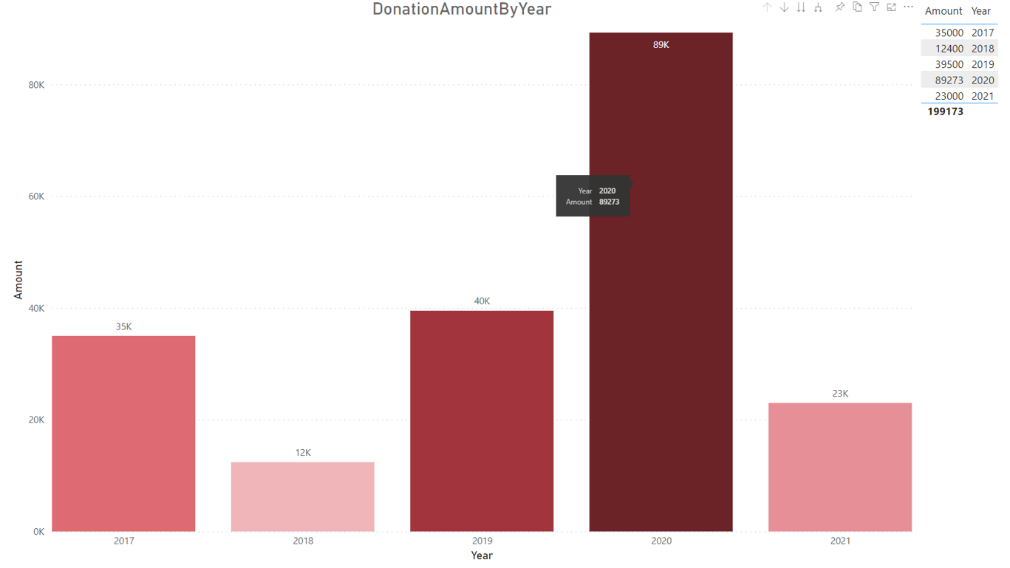
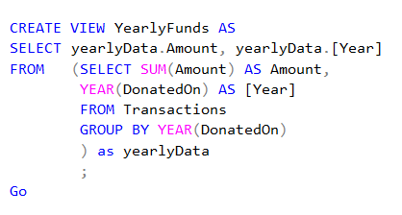
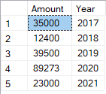
VIEWS
YEAR WISE GRANTS

Slide 20
THANK YOU

